Slide 1
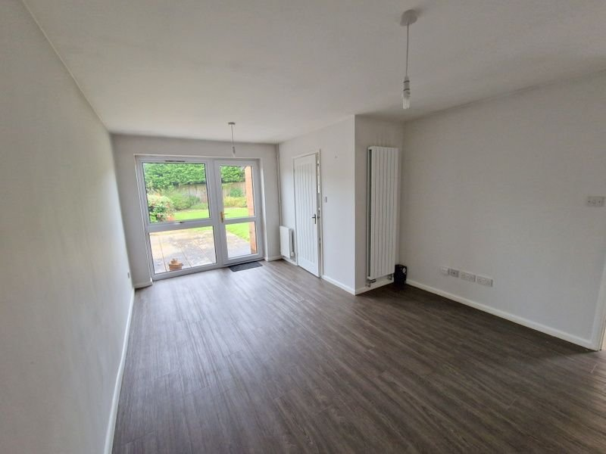
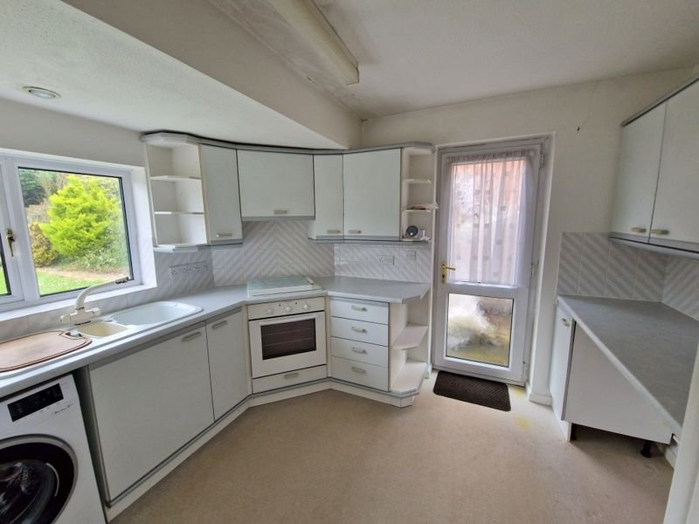
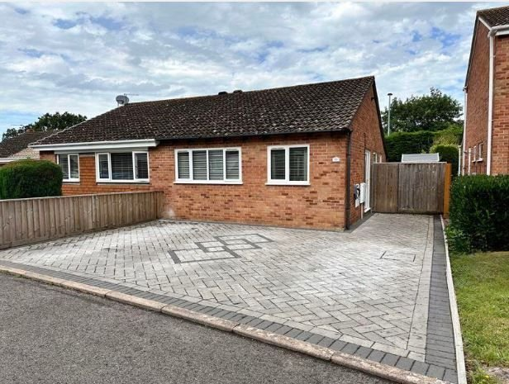
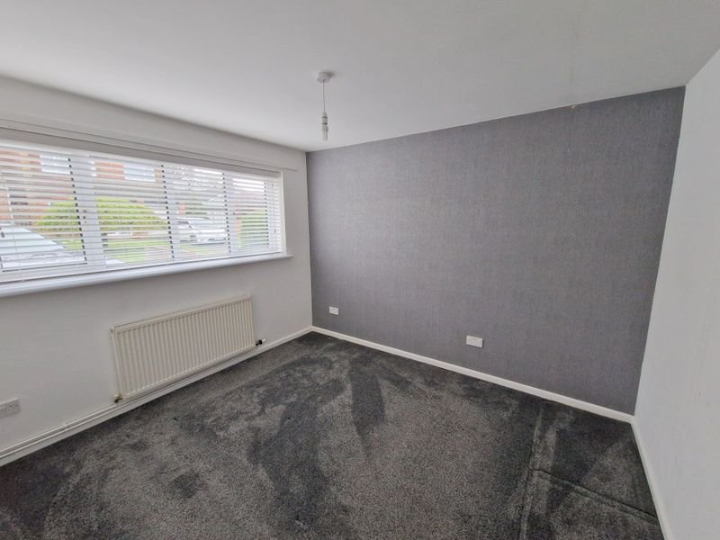
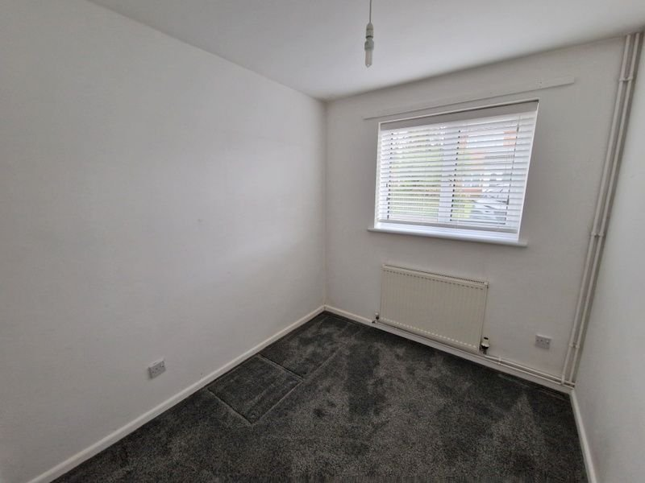
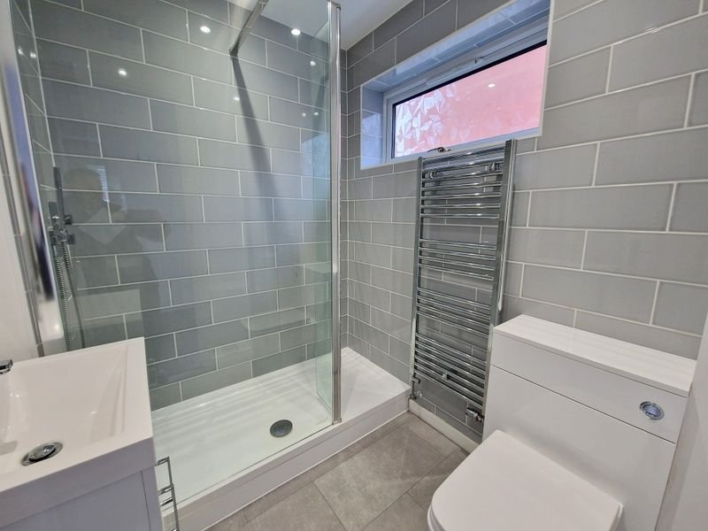
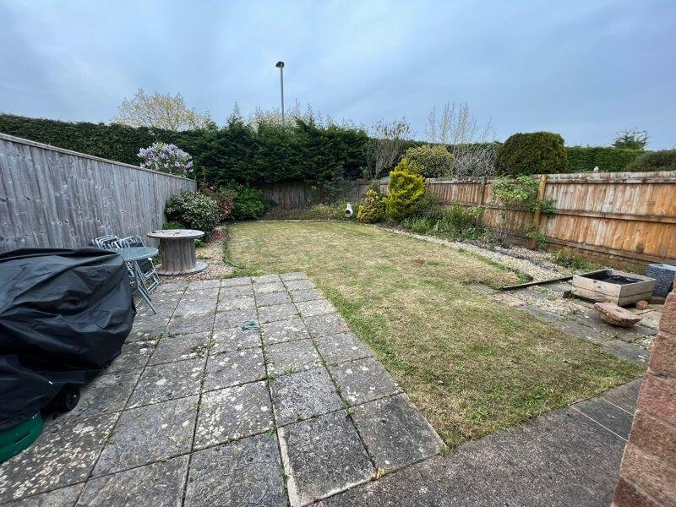
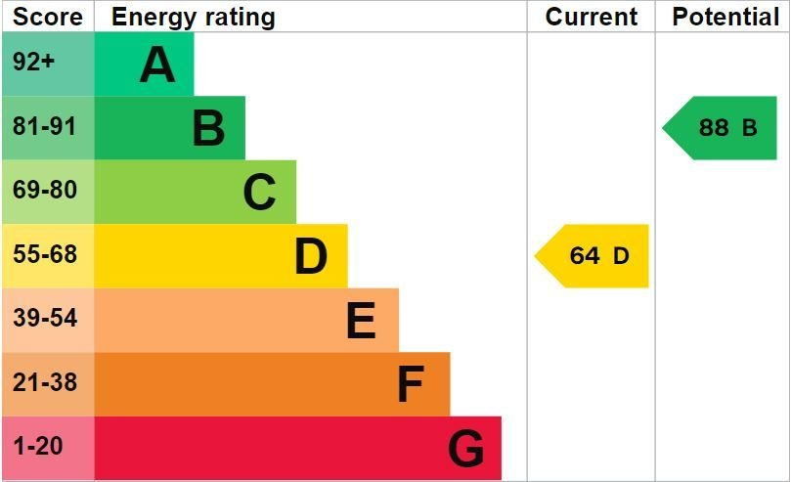
www.pennys.net
50 Evergreen Close, Exmouth, EX8 4RR
GUIDE PRICE £290,000
TENURE Freehold
A Well Presented Two Bedroom Semi-Detached Bungalow With Attractive Block Paved Driveway And Enclosed Rear Garden Offered For Sale With No Onward Chain
Kitchen With Built-In Oven & Hob • Attractive Living/Dining Room • Two Bedrooms •
Well Appointed Modern Shower Room/WC • Gas Central Heating •
uPVC Double Glazing • Block Paved Driveway Providing Ample Parking •
No Onward Chain •
Pennys Estate Agents Limited for themselves and for the vendor of this property whose agents they are give notice that:- (1) These particulars do not constitute any part of an offer or a contract. (2) All statements contained in these particulars are made without responsibility on the part of Pennys Estate Agents Limited. (3) None of the statements contained in these particulars are to be relied upon as a statement or representation of fact. (4) Any intending purchaser must satisfy himself/herself by inspection or otherwise as to the correctness of each of the statements contained in these particulars. (5) The vendor does not make or give and neither do Pennys Estate Agents Limited nor any person in their employment has any authority to make or give any representation or warranty whatever in relation to this property.
PENNYS ESTATE AGENTS
2 Rolle House, Rolle Street, Exmouth, Devon, EX8 2SN
Tel: 01395 264111 EMail: help@pennys.net

Slide 2
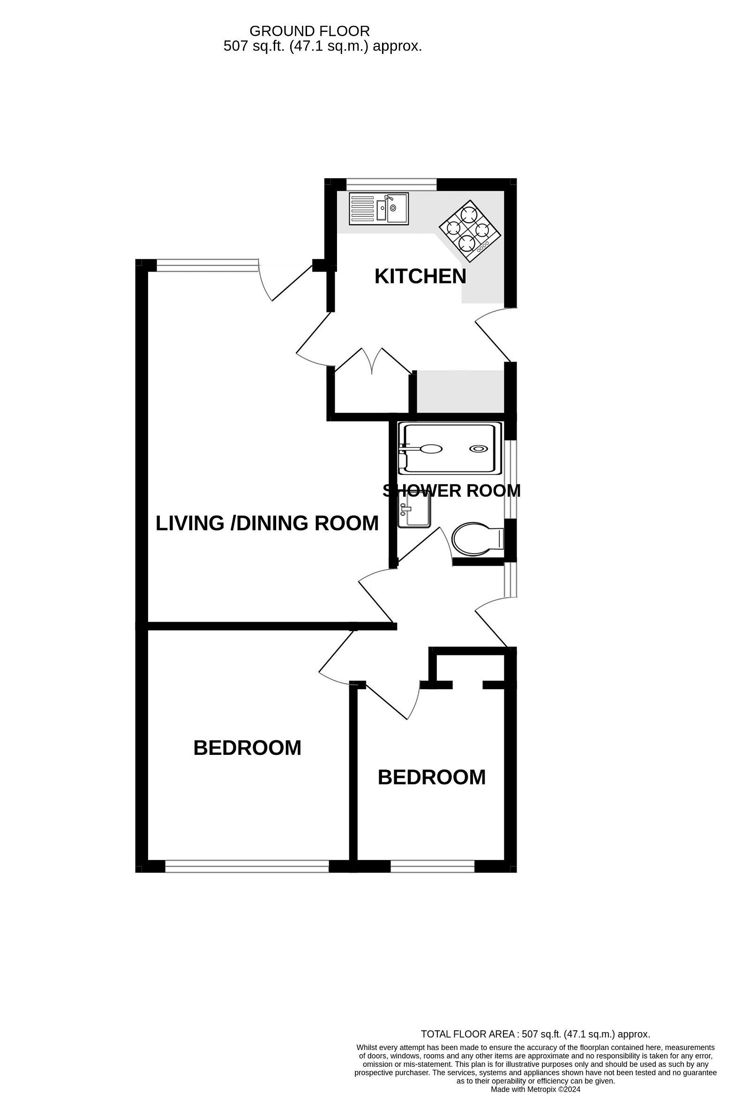
50 Evergreen Close, Exmouth, EX8 4RR THE ACCOMMODATION COMPRISES: LIVING/DINING ROOM: 5.11m x 3.48m (16'9" x 11'5") Narrowing to 8'8" (2.65m) KITCHEN: 3.28m x 2.59m (10'9" x 8'6") BEDROOM ONE: 3.38m x 3m (11'1" x 9'10") Measurement into wardrobe area. BEDROOM TWO: 2.51m x 2.26m (8'3" x 7'5") SHOWER ROOM/WC: 1.98m x 1.65m (6'6" x 5'5") REAR GARDEN: Approx 47'5" Length x 26'8" Width (14.46m x 8.12m)
.
FLOOR PLAN:

